Slide 1
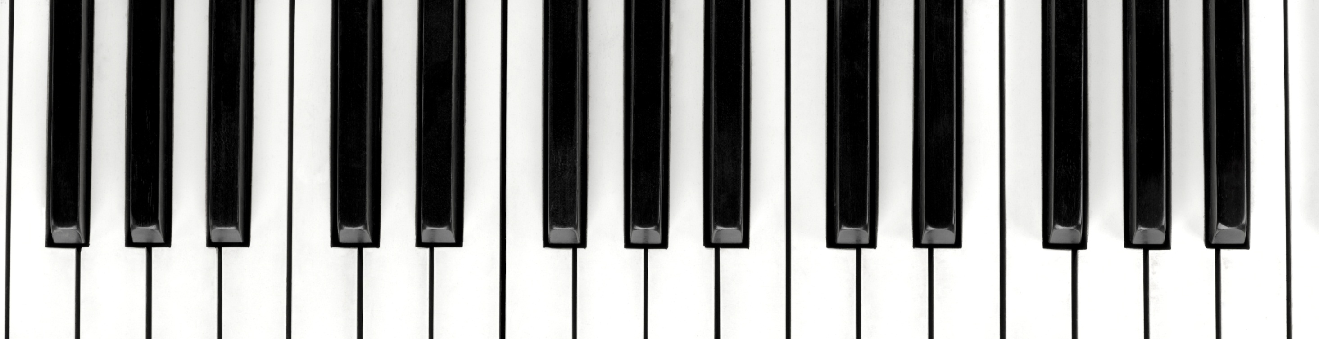
Music Genre Classification
Matt Juszczak, Casey Murdock, Dan Timke

Slide 2
Problem Statement
Primary Objective: To determine which deep learning methods are best suited for classifying music into the correct genres, and which song features must be extracted to do so.
Music streaming services rely on Music Genre Recognition to best direct their listeners to the types (genres) of songs they more want to hear.
Music Genre Recognition extracts relevant features from a song to identify in which genre the song is most likely to fit.
Neural networks are then constructed to detect feature patterns within these songs, allowing services to easily label the song as part of one genre, similar to an actual listener.

Slide 3
Data Assumptions and Model Hypotheses
For this project, we will be using song wav files, as well as a dataframe of all features specific to each song, to train our classification models and test them for accuracy and recall.
https://github.com/mdeff/fma
Key assumptions about our songs include:
Each song is the same duration.
The same set of features can be measured across each song.
Each song can be distinctly classified into one of 10 pre-existing genre labels.
After performing an Exploratory Data Analysis and Data Transformation Accordingly, we will be training the following classification models for our songs:
Random Forest (Base-Line)
Fully-Connected Dense Neural Network
Convolutional Neural Network
Long Short-Term Model
Given that each pattern recognized within a song is developed by the notes leading up to when the pattern is recognized, we believe that the LTSM model will perform best and be the most accurate in classifying songs, while the Convolutional Neural Network will struggle in identifying patterns within the condensed spectrograms.

Slide 4
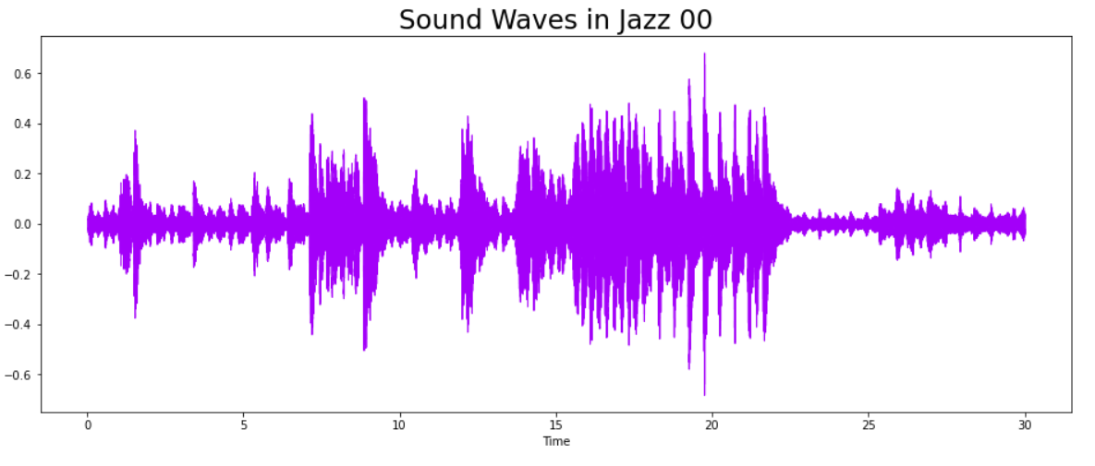

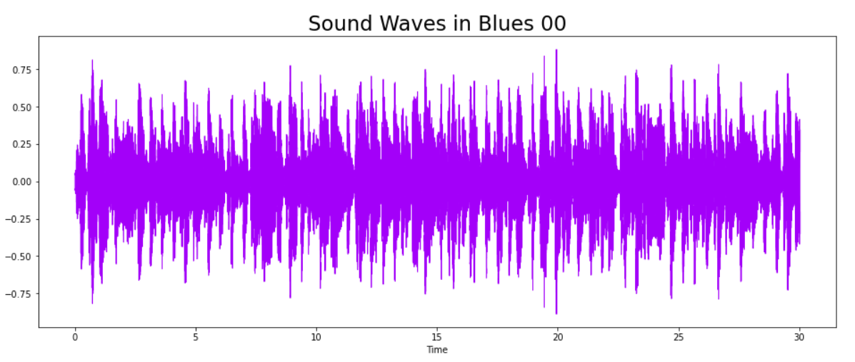
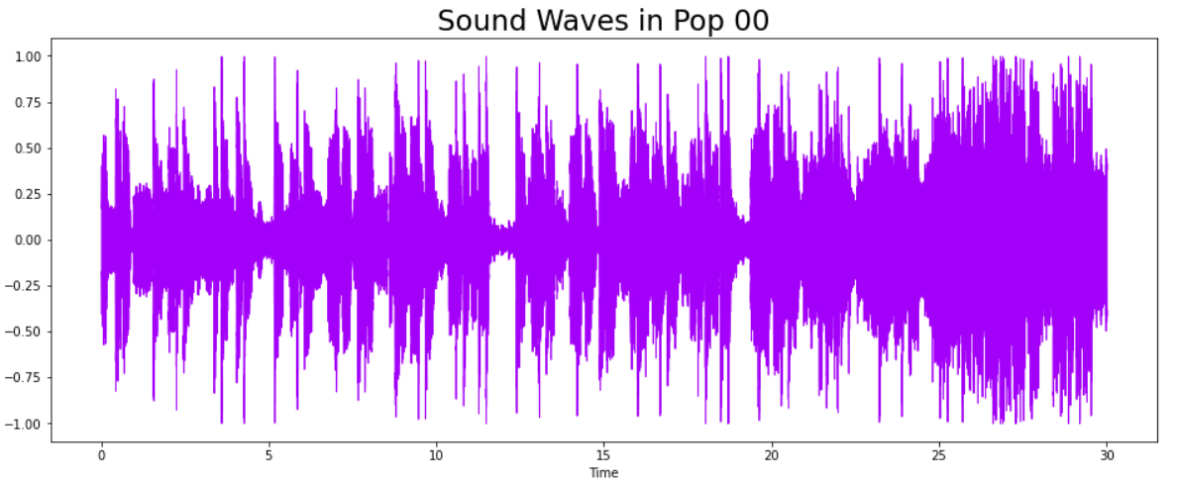
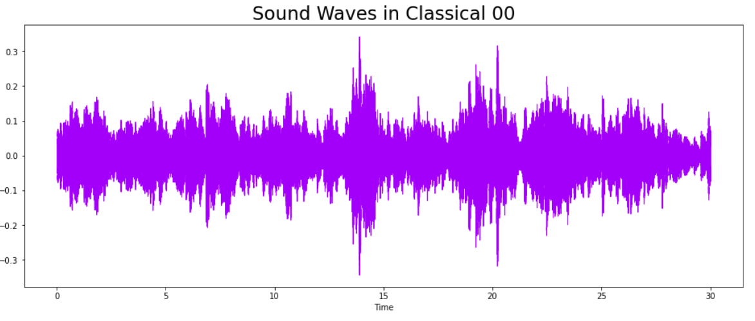
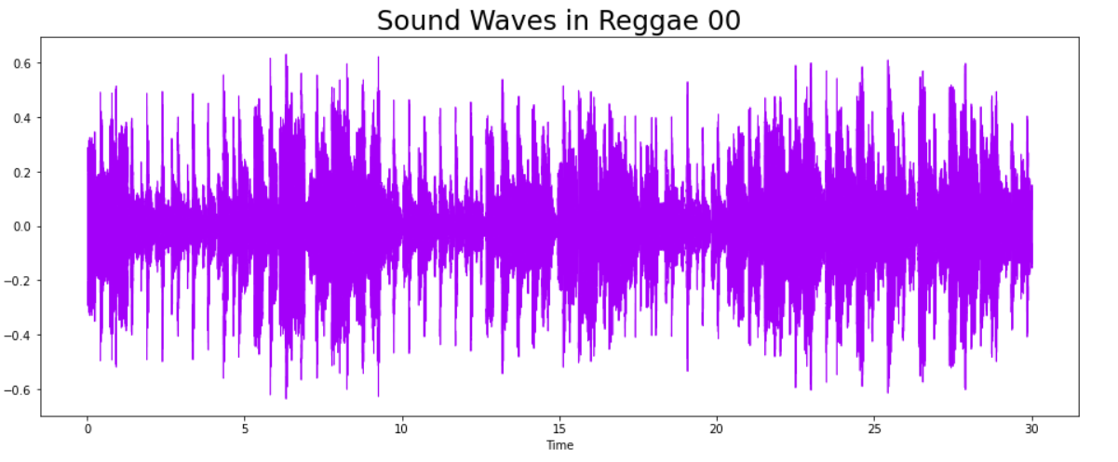
Exploratory Data Analysis – Genres and Sound Waves
Blues
Classical
Jazz
Pop
Reggae
Country
Disco
Hip-hop
Metal
Rock

Slide 5
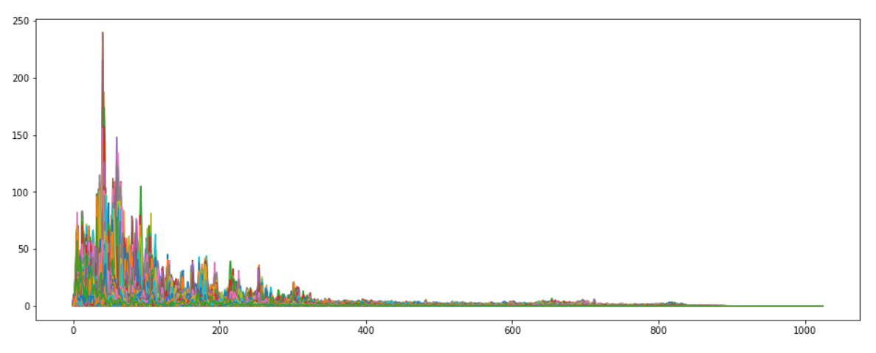
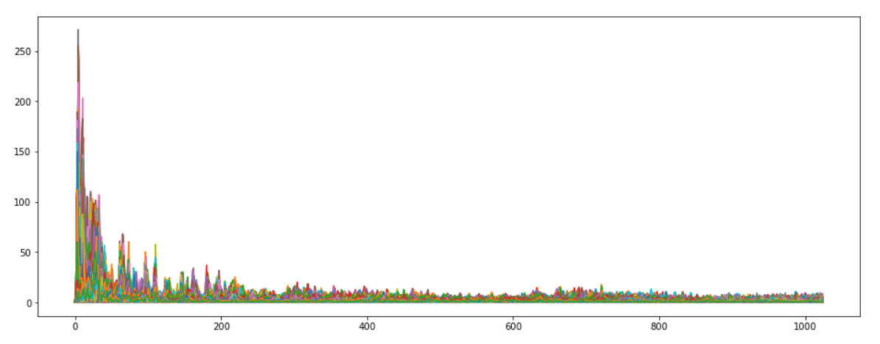
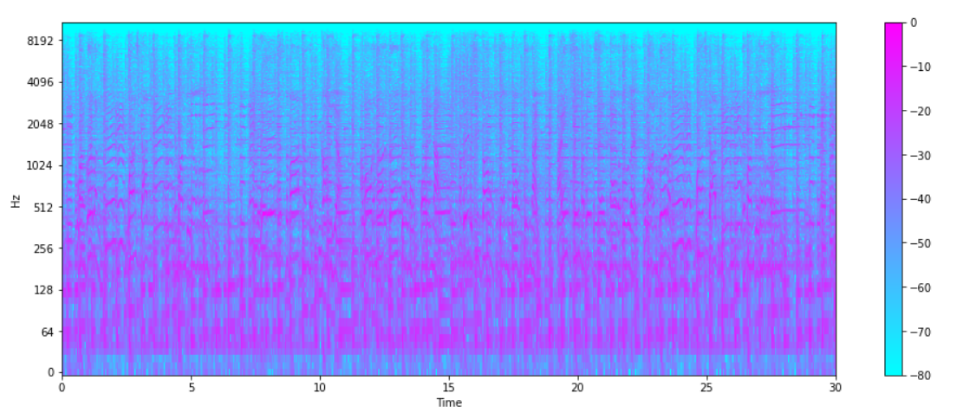
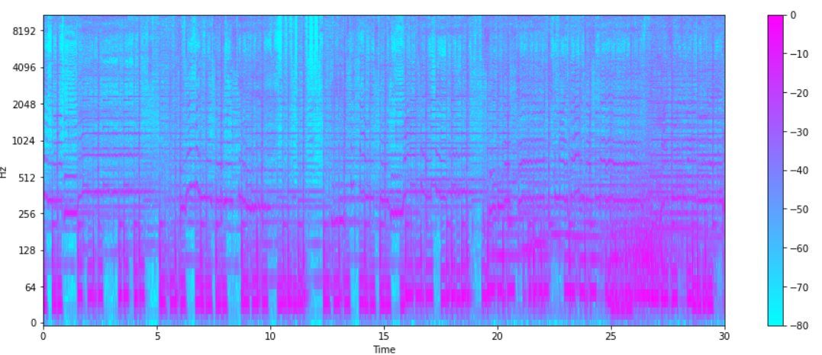
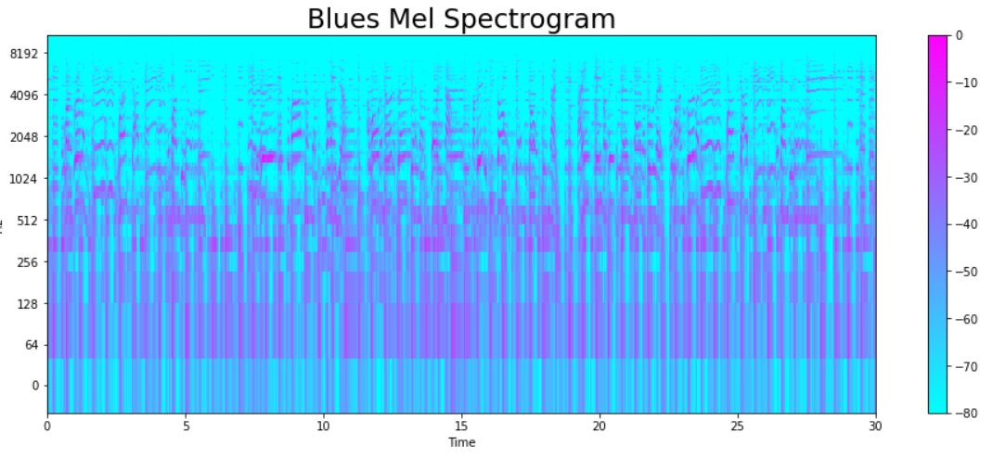
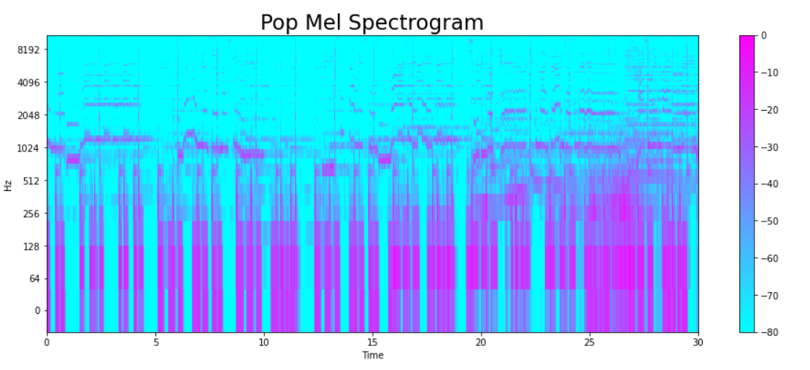
Exploratory Data Analysis – Mapping Frequencies
Blues
Pop
Fourier Transform
- Function that gets a signal in the time domain as input, and outputs its decomposition into frequencies
Spectrograms
- a visual representation of the spectrum of frequencies of a signal as it varies with time. When applied to an audio signal, spectrograms are sometimes called sonographs, voiceprints, or voicegrams
Mel Spectrogram
- Mel Scale, mathematically speaking, is the result of some non-linear transformation of the frequency scale.
Mel-Frequency Cepstral Coefficients
- The Mel frequency cepstral coefficients (MFCCs) of a signal are a small set of features (usually about 10–20) which concisely describe the overall shape of a spectral envelope. It models the characteristics of the human voice.

Slide 6
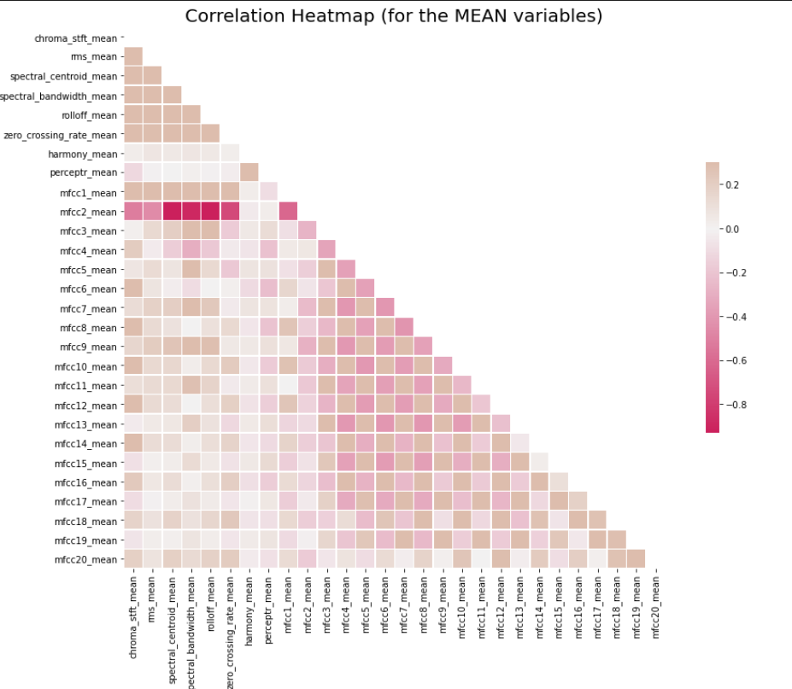
Exploratory Data Analysis- Correlation of Features

Slide 7
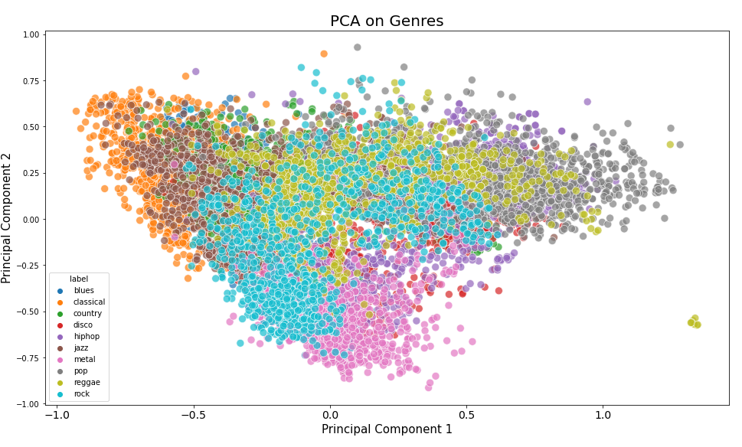
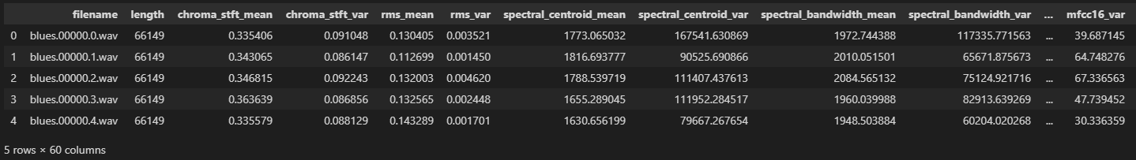
Feature Engineering and Data Transformations

Slide 8
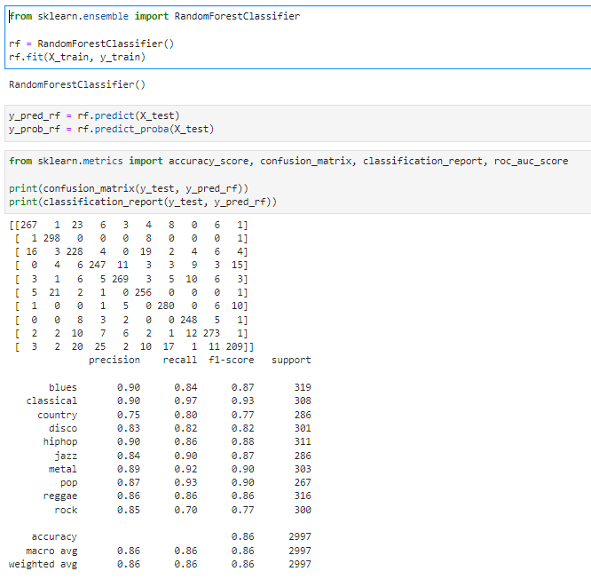
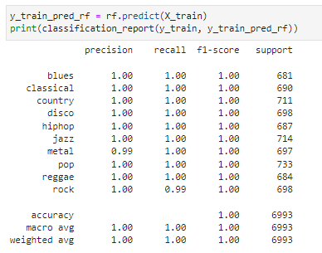
Baseline Classification Model – Random Forest
Test Prediction
Train Prediction
To establish a baseline genre classifier for measuring the success of our deep learning models, we will run a supervised/ensemble learning model (in this case, Random Forest) to classify the test and train sets.
Though the Random Forest’s bootstrapping technique appears to be fairly accurate in predicting the test set, it is 100% accurate in predicting the training set, indicating that the model completely overfits the training data.

Slide 9
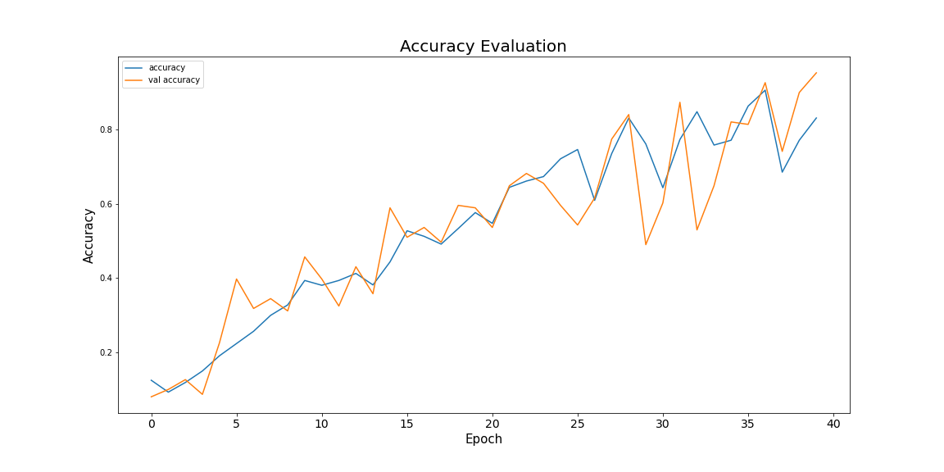
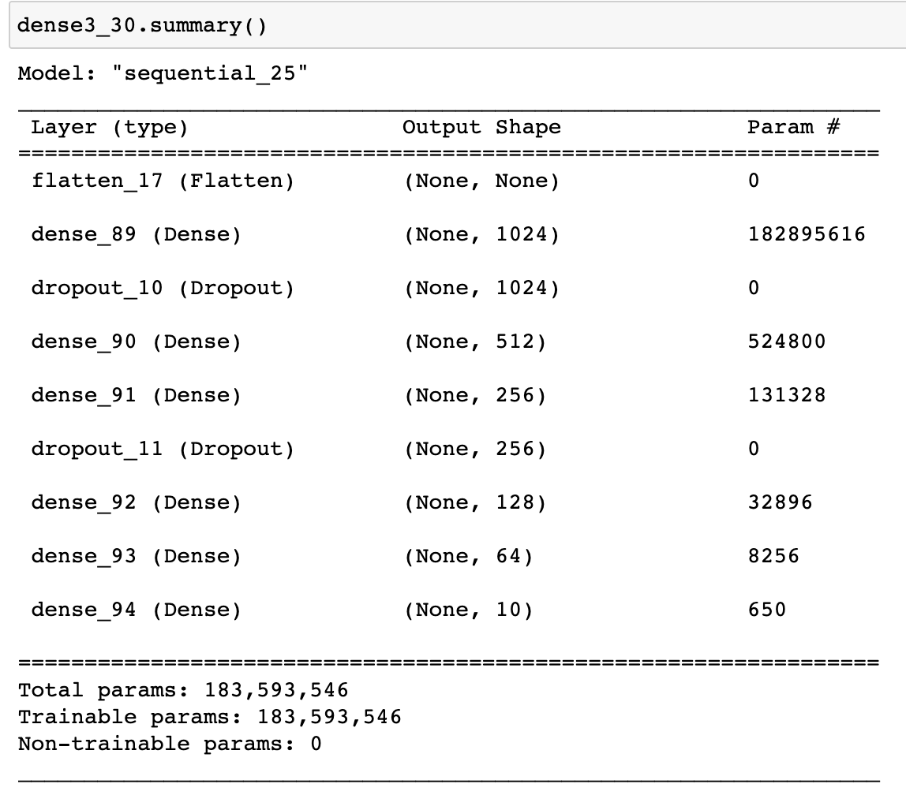
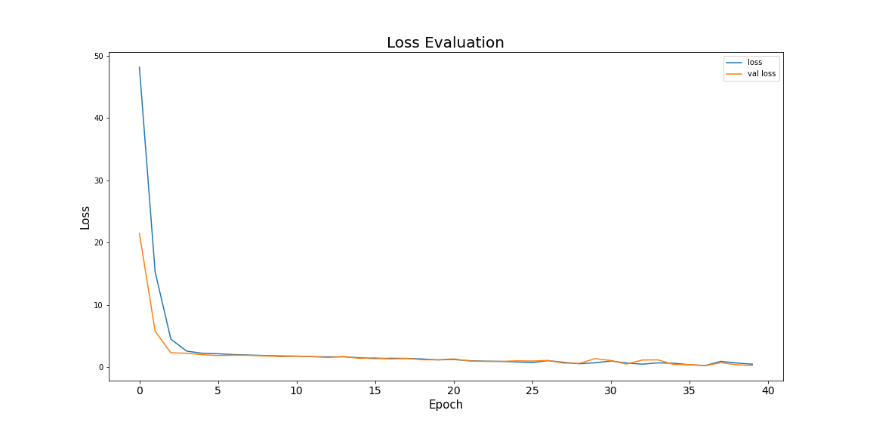
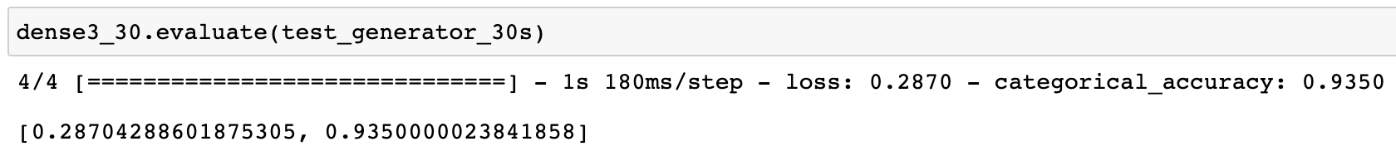
Fully Connected Dense Layers
Using 30s spectrograms, the fully connected dense network manages to get 90% accuracy on the training, validation, and test sets
Meant as a baseline for other models since this is fairly simple
Also tried using this network on the MFCCs but accuracy seemed to top out around 30%

Slide 10
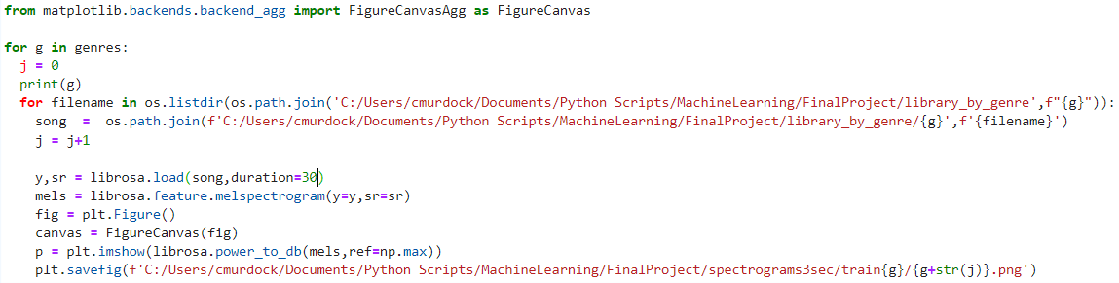
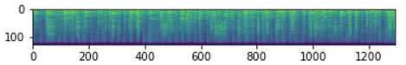
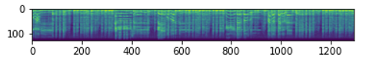
Convolutional Neural Networks Model (Data Transformation)
Knowing that CNN’s work best in detecting spatial patterns in images and classifying them accordingly, we will transform the wav files into spectrograms, which visualize the variations in songs’ frequencies over time.
To accomplish this, we import and apply the Librosa package, which is specifically designed for audio analysis. Its melspectrogram function will map the changes in frequencies on a mel-scaled plot.

Slide 11
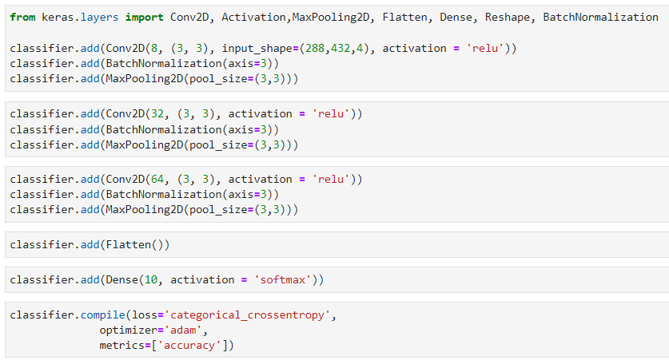
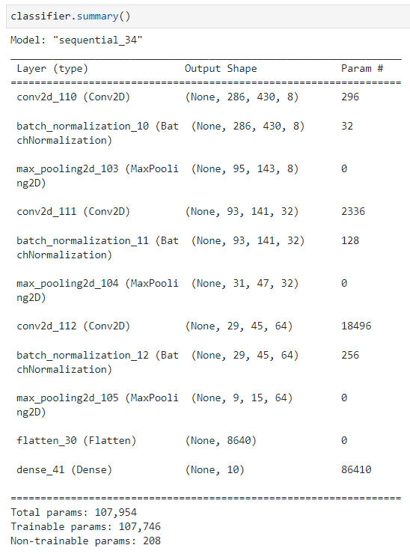
Convolutional Neural Networks Model (Model Fitting)

Slide 12
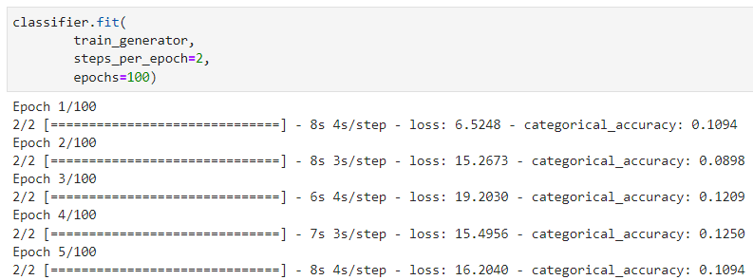
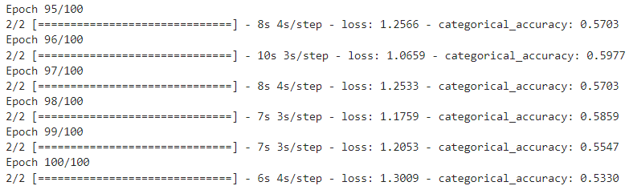
Convolutional Neural Networks Model (Model Results)
In fitting the CNN model to the training set of spectrograms, we can easily see how poorly the model performs in correctly classifying the training set after just a few epochs.
The accuracy moderately improves after running 100 epochs, suggesting that it could eventually become a more accurate model after running a large number of epochs, though this would be both inefficient and computationally expensive.

Slide 13
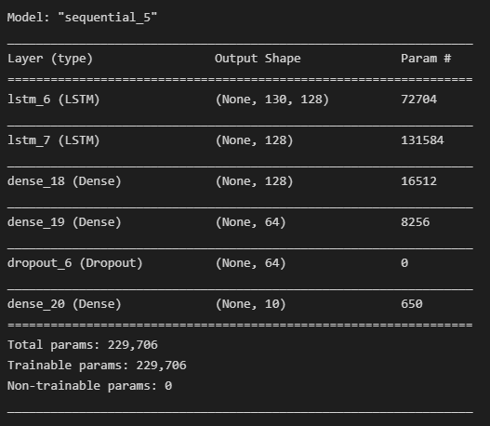
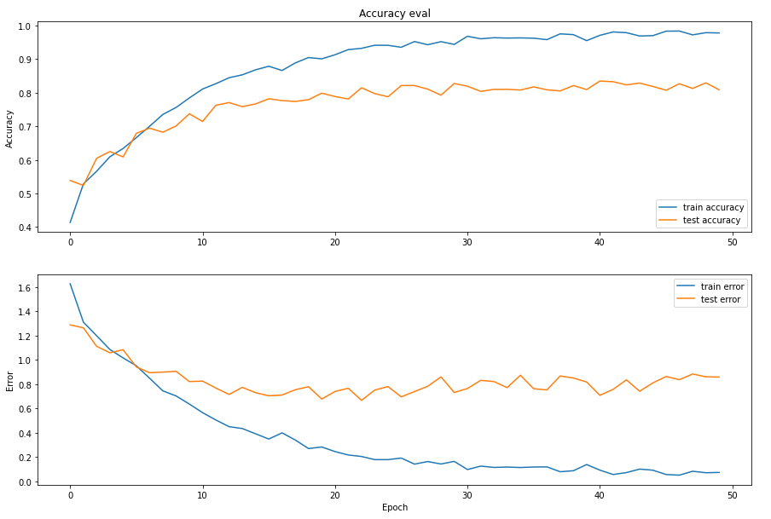
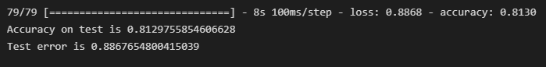
Long Short-Term Memory Model

Slide 14
Results/Accuracy Comparison
Model | Random Forest | Dense Network | CNN | LSTM
Test Accuracy | 86% | 93% | 53% | 82%
The Random Forest baseline proved a better baseline than the simplest dense network.
CNN could perhaps continue to improve over more epochs, but slow learning was an issue.
The dense network slightly overperformed the random forest baseline and LSTM slightly underperformed.

Slide 15
Proposed Solution (Model Technique)
Based on our results with this data, the fully connected network is possibly the best option, but has issues
Computationally - calculating MFCC and features based on them is trivial compared to creating the actual spectrograms and then analyzing those
Of the deep learning models, the dense neural net performed the best, but there are issues – each epoch took about 3x as long to run as the other models
Error and loss rates on the validation set seem to track the training data too well, I'm presenting this, but I'm not buying it

Slide 16
Considerations for Next Steps and Feature Changes
Considerations
Need more, better data – only 1000 curated songs
Might not work in the real world where the model can get hung up on the length of the song or just the volume
If spectrograms are created for other reasons, could be useful, but otherwise if you just need to classify by genre, might be best to just use something like a random forest classifier
Next Steps
Test on more, real-world data

